Slide 1
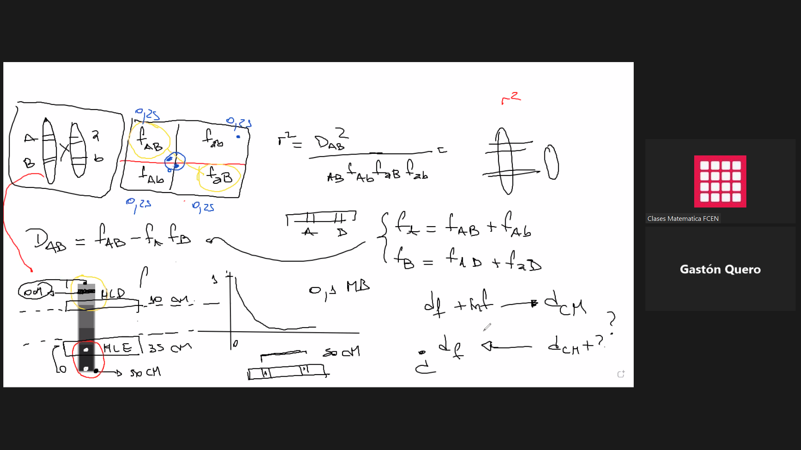

Slide 2
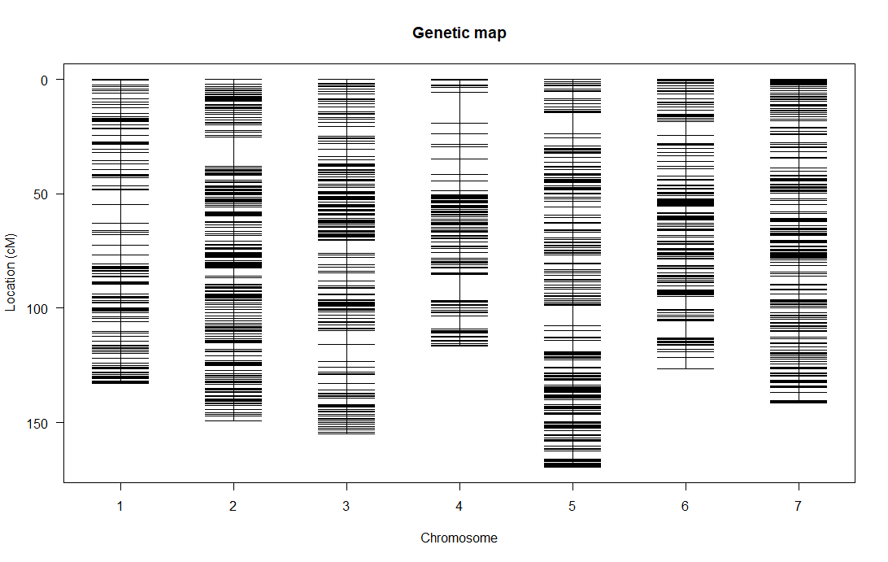
Población de GWAS - Cebada
No. individuals: 148
No. phenotypes: 6
Percent phenotyped:
100 100 100 100 100 99.3
No. chromosomes: 7
Autosomes: 1 2 3 4 5 6 7
Total markers: 6340
No. markers:
535 ; 1093 ; 1039 ; 644 ; 1148 ;817 ;1064
Percent genotyped: 98.8
Genotypes (%): AA:53.8 AB:46.2

Slide 3
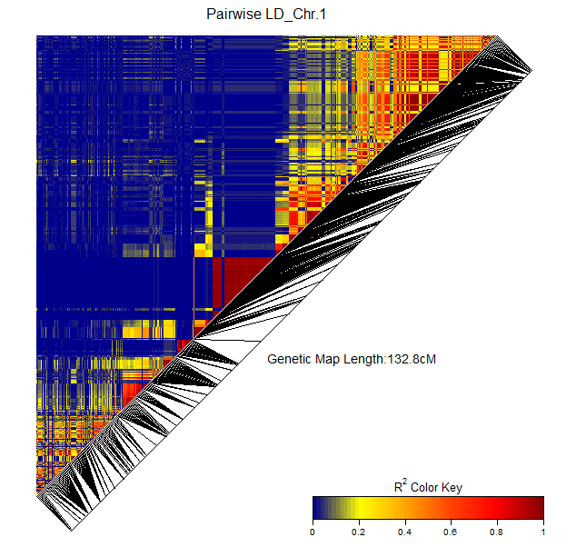
Población de GWAS - Cebada
Hay que hacer un if en el seteo de la función que calcula el r2
genetic.distances : A numeric vector of map locations of the SNPs, in the same order as SNPs listed in gdat, in terms of genetic or physical distances.
Physical distances should be in bases, genetic distances should be in centiMorgans (cM).
When gdat is not an object of class LDheatmap, the default is a vector that represents equi-spaced markers, 1kb (1000 bases) apart.
When gdat is an object of class LDheatmap, the genetic.distances argument is taken to be the genetic.distances list item of gdat.
distances : A character string to specify whether the provided map locations are in physical or genetic distances.
If distances="physical" (default), the text describing the total length of the region will be “Physical Length:XXkb” where XX is the length of the region in kilobases.
If distances="genetic", the text will be “Genetic Map Length:YYcM” where YY is the length of the region in centiMorgans.
If gdat is an object of class LDheatmap, distances is taken from gdat.

Slide 4
Población de GWAS - Cebada
Hay que hacer un if en el seteo de la función que calcula el r2
genetic.distances : A numeric vector of map locations of the SNPs, in the same order as SNPs listed in gdat, in terms of genetic or physical distances.
Physical distances should be in bases, genetic distances should be in centiMorgans (cM).
When gdat is not an object of class LDheatmap, the default is a vector that represents equi-spaced markers, 1kb (1000 bases) apart.
When gdat is an object of class LDheatmap, the genetic.distances argument is taken to be the genetic.distances list item of gdat.
distances : A character string to specify whether the provided map locations are in physical or genetic distances.
If distances="physical" (default), the text describing the total length of the region will be “Physical Length:XXkb” where XX is the length of the region in kilobases.
If distances="genetic", the text will be “Genetic Map Length:YYcM” where YY is the length of the region in centiMorgans.
If gdat is an object of class LDheatmap, distances is taken from gdat.

